Slide 1
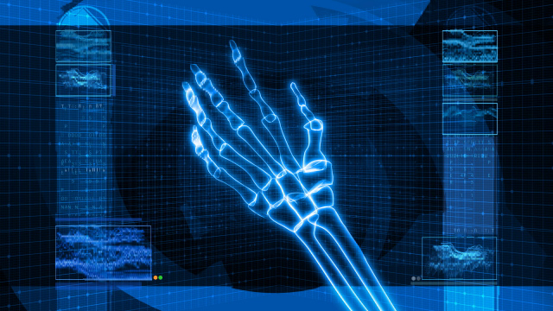
Bone and Joint Health Seminar

Slide 2
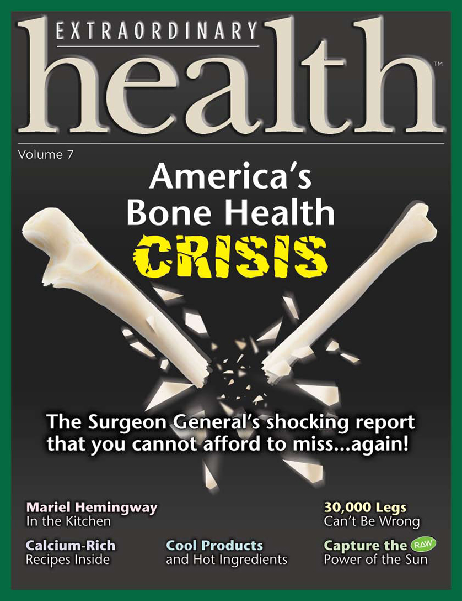

Slide 3
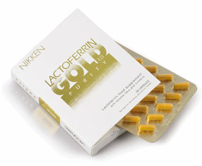
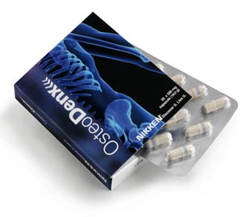
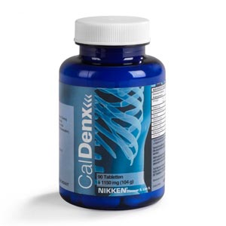
PACKAGE
Bone Health
Lactoferrin Gold 1.8®
- Revitalizes intestinal health
- Promotes nutrient absorption
OsteoDenx®
- Optimizes bone/joint health
- Target delivers bone nutrients
CalDenx
- Provides bone minerals
- Supports calcium balance
These statements have not been evaluated by the Food and Drug Administration. This product is not intended to diagnose, treat, cure, or prevent any disease.

Slide 4
WARNING!
The Information you are about to receive may:
  Change your Life.
  Get you Well.
  Keep you Well.
  Improve your Quality of Life.
  Set you FREE !
!
Listen closely for you and your families’ sake.

Slide 5
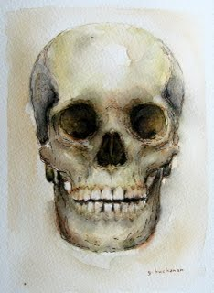
OsteoWorks
THE PERFECT STORM
Solid Company
Growth Industries
Home Based
Health Based
Patented Technology
Clinically Proven
Society is Searching
Bone Health
Life Wealth

Slide 6
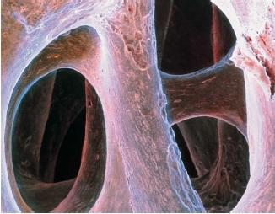

The Bone Health Crisis
Danger
+ Opportunity
The cost to US society in 2004 was $840 Billion (JAMA, 2009)

Slide 7
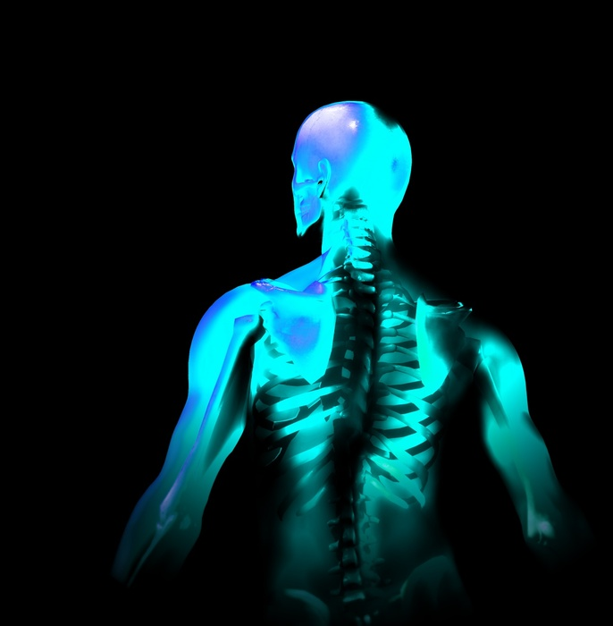
What if you found…
a revolutionary, patented, breakthrough technology that could solve one of medicines most fundamental challenges, slow the aging process and is positioned to be…the only true
solution in a $10,400,000,000
dollar economy?
Would you seize the opportunity?

Slide 8
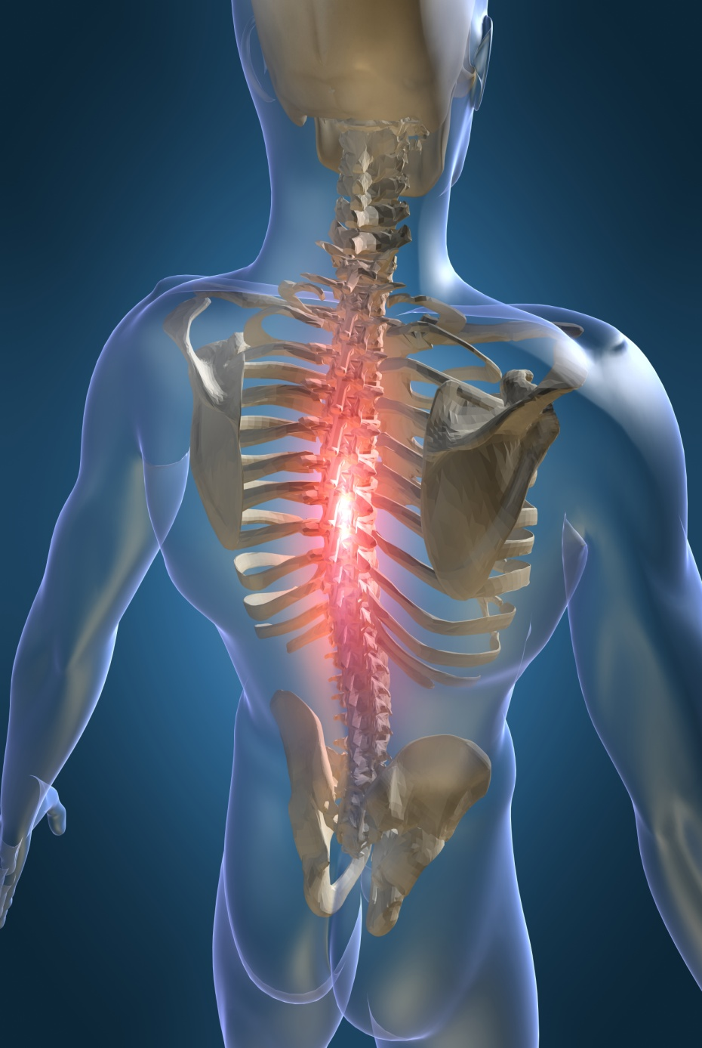
Your Skeletal System…
Why is it so important?

Slide 9
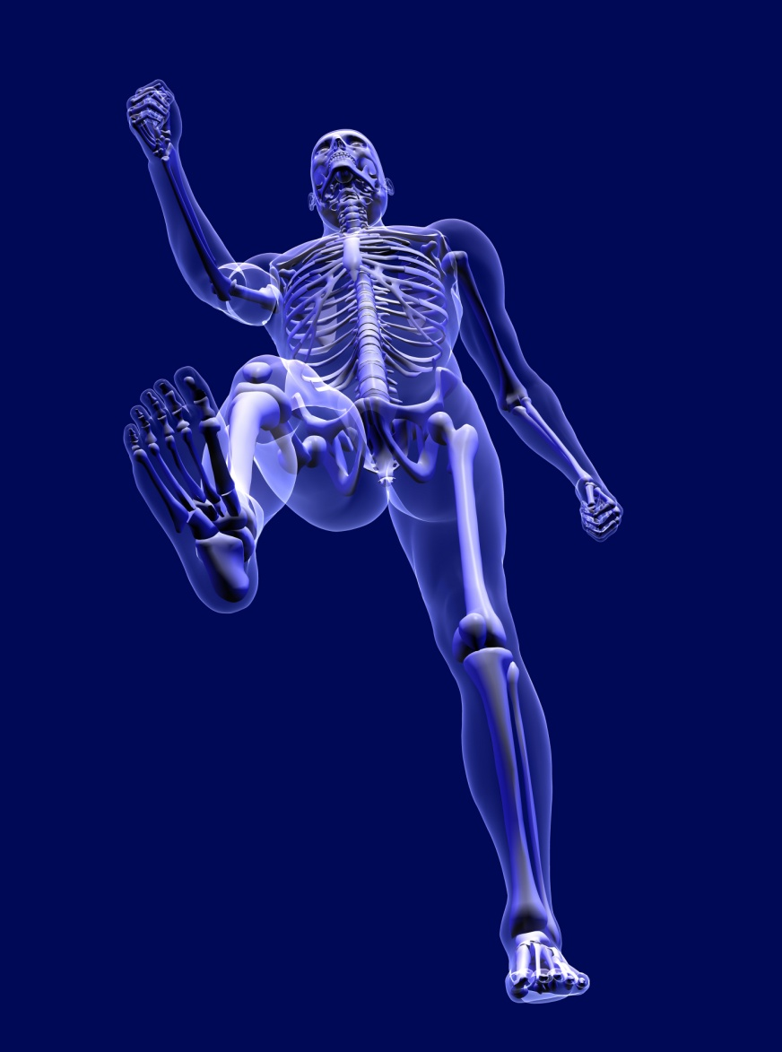
Healthy OSTEO System
Known Functions
The bones create a mechanism allowing movement and form.

Slide 10
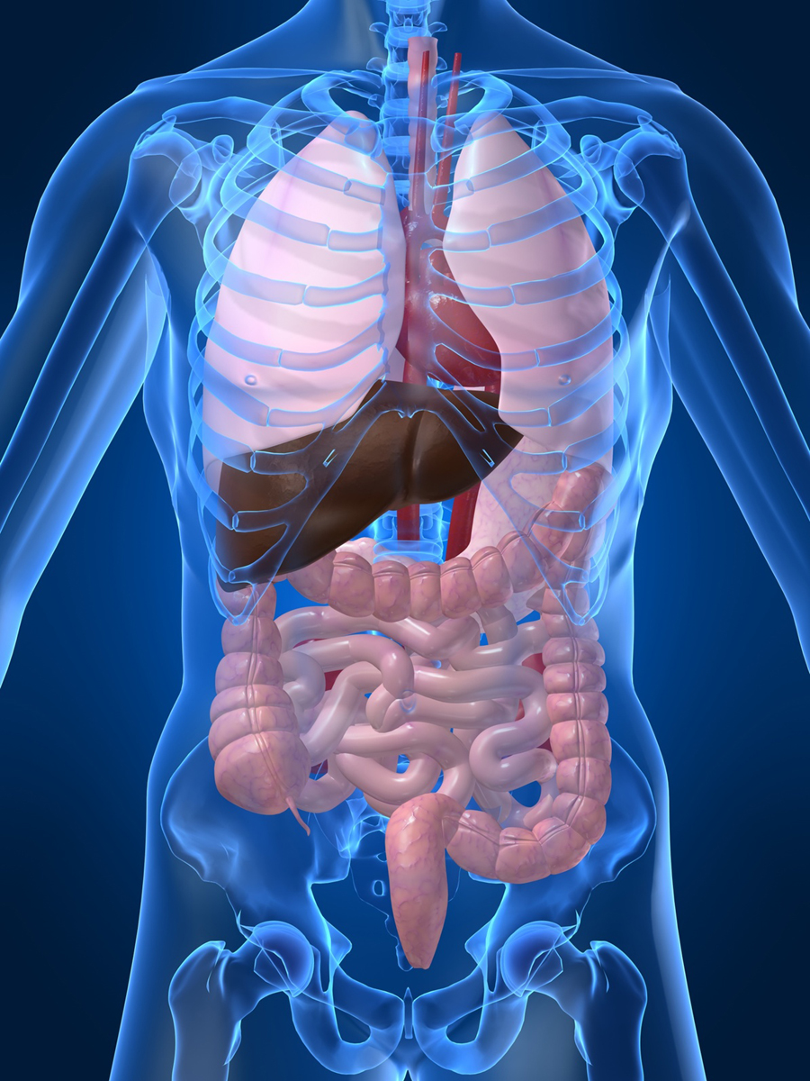
Healthy OSTEO System
Known Functions
The bones create a mechanism allowing movement and form.
Create a shield and protection for vital organs (lungs, brain, heart, liver, etc.)

Slide 11
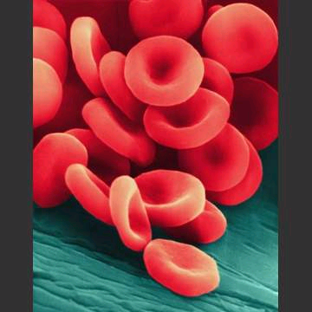
Healthy OSTEO System
Known Functions
The bones create a mechanism allowing movement and form.
Create a shield and protection for vital organs (lungs, brain, heart, liver, etc.)
The marrow contains stem cells and manufactures red blood cells…
as well as white blood cells.

Slide 12
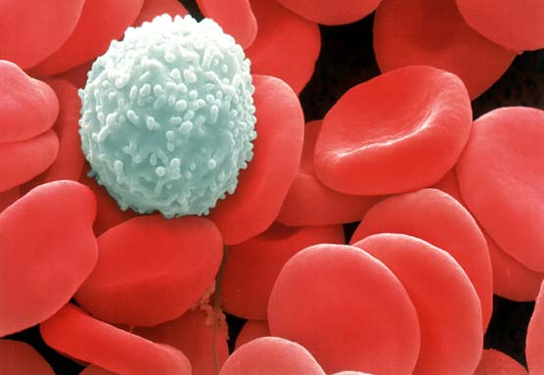
Healthy OSTEO System
Known Functions
The bones create a mechanism allowing movement and form.
Create a shield and protection for vital organs (lungs, brain, heart, liver, etc.)
The marrow contains stem cells and manufactures red blood cells…
as well as white blood cells.

Slide 13
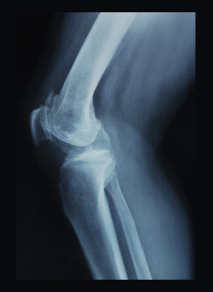
Healthy OSTEO System
Known Functions
The bones create a mechanism allowing movement and form.
Create a shield and protection for vital organs (lungs, brain, heart, liver, etc.)
The marrow contains stem cells and manufactures red blood cells…
as well as white blood cells.
Function as a chemical bank creating a system of regular deposits and withdrawals of trace minerals, calcium, phosphorus, etc.

Slide 14
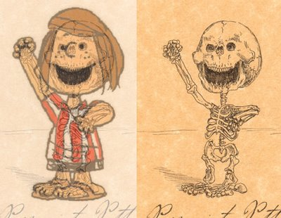
The Challenge
The Surgeon General Reports
12 Million Americans
have Osteoporosis.
40 Million Americans: low bone mass or Osteopenia
-Hip fractures up 25% (1990-2000)
-Greatest risk: hip, spine, wrist.
66 Million - joint related issues.
TOTAL: 118 Million
“They will not fall and break their bones, they will break their bone…and fall.”
Studies indicate our teenage youth are at risk for osteoporosis.

Slide 15
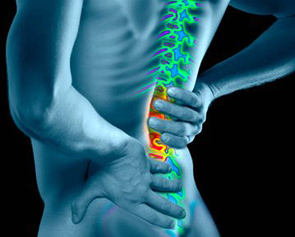
We will discuss…
Bone Replacement
  10 times in the average lifetime
  5 times before age 20
Factors playing a role in bone replenishment.

Slide 16
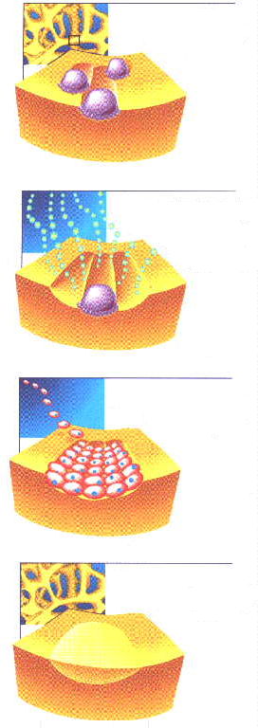
OSTEO System
Normal functions of bone tissue

Slide 17

OSTEO System
Normal functions of bone tissue
Bone Resorption (Loss) Osteoclasts excavate small pits in bone and release calcium for body functions

Slide 18

OSTEO System
Normal functions of bone tissue
Bone Resorption (Loss) Osteoclasts excavate small pits in bone and release calcium for body functions
Bone Markers Fragments of excavated bone collagen are released into biological fluids

Slide 19

OSTEO System
Normal functions of bone tissue
Bone Resorption (Loss) Osteoclasts excavate small pits in bone and release calcium for body functions
Bone Markers Fragments of excavated bone collagen are released into biological fluids
Bone Formation Osteoblasts deposit new collagen to fill excavated pits on bone

Slide 20

OSTEO System
Normal functions of bone tissue
Bone Resorption (Loss) Osteoclasts excavate small pits in bone and release calcium for body functions
Bone Markers Fragments of excavated bone collagen are released into biological fluids
Bone Formation Osteoblasts deposit new collagen to fill excavated pits on bone
Bone Health When resorption / formation are in balance there is no net change in bone mass

Slide 21
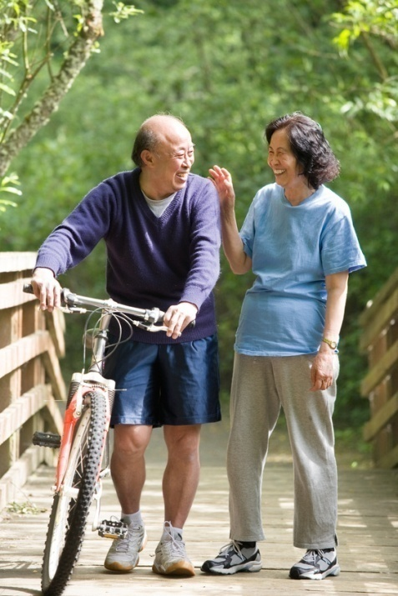
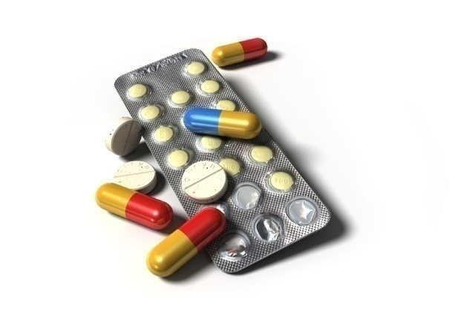
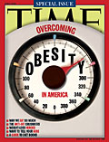
Lifestyle
Physical activity is known to help build up bone, but few adults receive the exercise they need.
Medications
Weight issues impose stress on the skeletal structure.
Caffeine, alcohol and acidic lifestyles all lead to weakened bones.
Age

Slide 22

Men at Risk
Hormonal issues (hypogonadism)
Weight, smoking, lack of activity, sunlight.
Cortisone, prednisone, various heart meds, & some prostate cancer treatments.
Significantly under diagnosed (msn.com)
5 million have/at risk for Osteoporosis.
“(Men) have a greater risk of developing osteoporosis than they do prostate cancer.”
(Pro-Solutions for Healthy Living. Vol 3. Issue 3)

Slide 23
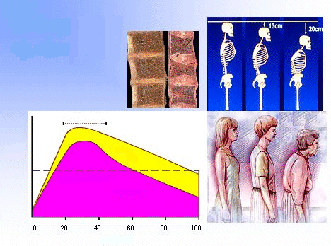
Osteoporosis…
What does it mean to you?
Height loss
Impingement of nerves
Pain
Decreased organ function
Decreased mobility
Fear of activity

Slide 24
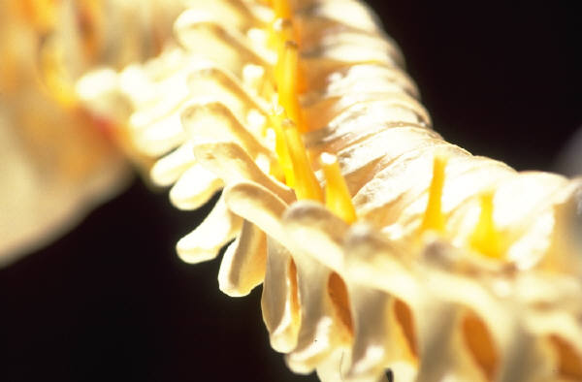
Calcium Supplementation
Raw material for bone regeneration.
Calcium sources: greens, milk, fortified foods, supplements, etc.
The problem lies in absorption.
Calcium needs to be converted to a usable form.

Slide 25
Supplements
Dietary calcium is not readily used in metabolic processes.
Often never reaches the intended destination.
Much of what we intake
is excreted
Calcium supplementation has been
blamed for kidney stones
Calcium may be making you sicker… hardening of the arteries and high blood pressure.

Slide 26
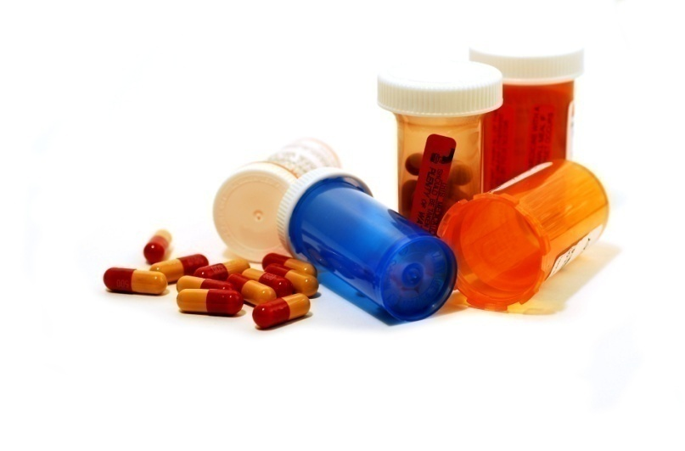
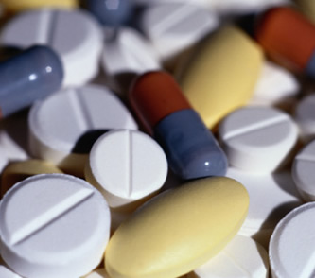
OSTEO System
Limitations
Most Prescription Drugs and Nutritional Supplements:
lack target site-delivery systems to avoid chemical build-up.

Slide 27
OSTEO System
Limitations
Most Prescription Drugs and Nutritional Supplements:
lack target site-delivery systems to avoid chemical build-up.
have limited ability to promote bone mineral density (BMD).

Slide 28
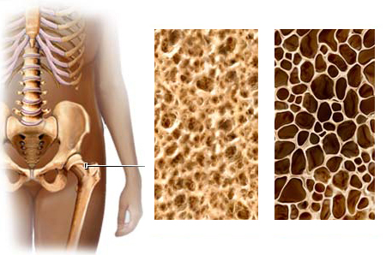
OSTEO System
Limitations
Most Prescription Drugs and Nutritional Supplements:
lack target site-delivery systems to avoid chemical build-up.
have limited ability to promote bone mineral density (BMD).
may slow down bone resorption (loss) but can’t form new bone mass

Slide 29

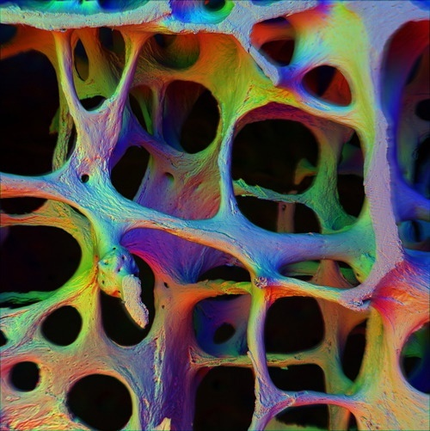
OSTEO System
Limitations
Most Prescription Drugs and Nutritional Supplements:
lack target site-delivery systems to avoid chemical build-up.
have limited ability to promote bone mineral density (BMD).
may slow down bone resorption (loss) but can’t form new bone mass
by slowing down bone resorption (loss) cause several side effects
Up to 50% of the patients who are prescribed bisphosphonates take themselves off the medications within one month.

Slide 30
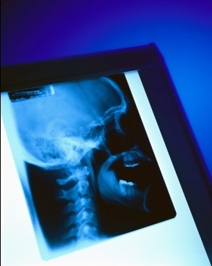
RISKS of Osteo Drugs
Jaw decay
Disabling pain
Difficulty swallowing
Heartburn
Inflammation of the esophagus
Esophageal cancer
Altered taste
Numbness
Mental irritability
Chest pain
Seizures
Anemia
Blood clotting disorders
Decreased joint mobility
Eye problems
Skin rash
Gastrointestinal abnormalities
Severe Constipation
Slower bone fracture recovery
Bones harden - become brittle Townsend letter July 2009
Not everything that is “free” is worth the cost.
Will your insurance pay for the funeral as well?

Slide 31

Skin infections, some requiring hospitalization, and other infections, such as in the ears, urinary tract and the heart. Back pain and pain in the muscles and bones have been reported, as have elevated cholesterol levels.
Double your risk of cancer (University of Oxford : BMJ. 2010;341:c4506)
Hypocalcemia (blood calcium levels are too low)
Eye inflammation – can lead to blindness.
Severe musculoskeletal pain
Stomach ulcers, liver damage, kidney failure
Atrial fibrillation risk up 86% (Archives of internal Medicine)
Increased risk of unusual femur fractures, 94 percent of patients who had experienced a femur break had been on bisphosphonate drugs. Most of them had taken the drugs longer than five years.

Slide 32
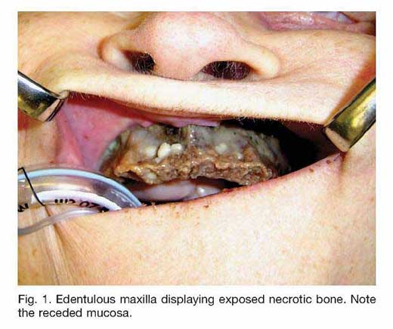
Notes:
32

Slide 33
Bone Building Tips (Mercola.com)
Eat a healthful diet based on your body's unique nutritional type.
Eating high quality, organic, biodynamic, locally-grown food will naturally increase your bone density and decrease your risk of developing osteoporosis. If you find it difficult to eat the recommended amount of vegetables you need daily, you can try vegetable juicing.
One food in particular that is worth mentioning are onions, which are high in gamma-glutamyl peptides that have been shown to increase bone density.
Also remember that you need high quality protein like organic free-range eggs and grass-fed meats, because amino acids are part of your bone matrix. If you don’t consume enough of specific amino acids your body can’t form strong, dense bones.
Avoid processed foods. If you eat a diet full of processed foods, it will produce biochemical and metabolic conditions in your body that will decrease your bone density, so avoiding processed foods is a first step in the right direction.
Consume a healthy balance between omega-6 and omega-3 fats. Most everyone needs to take a high quality, animal-based omega 3 fat. I recommend krill oil, as I believe it’s a superior source of omega 3’s. You’ll also want to reduce or eliminate the amount of processed vegetable oils you consume, such as corn, canola, safflower, and soy oil.
Avoid gluten, a grain protein that has been shown to decrease bone density. Gluten is found in wheat, barley, rye, oats and spelt.
Avoid soda and sugar, particularly fructose, which increase bone damage by depleting your bones of calcium.
Optimize your vitamin D levels, ideally through proper amounts of sun exposure. Vitamin D builds your bone density by helping your body absorb calcium.
Supplement with vitamin K2 if you are not getting enough from food alone. Fermented foods, such as natto, typically have the highest concentration of vitamin K found in the human diet and can provide several milligrams of vitamin K2 on a daily basis.
Vitamin K2 serves as the biological "glue" that helps plug the calcium into your bone matrix and is crucial for preventing osteoporosis. I recommend taking about 150 mcg per day.
Make sure your diet includes sufficient amounts of magnesium, manganese, zinc, silicon and boron, or take them as supplements. The best form of calcium is to consume raw dairy regularly. Additionally, cheese is a good source of vitamin K2.
Replace your calcium supplements with natural salts -- Dr. Robert Thompson M.D. wrote an entire book, The Calcium Lie, addressing this important issue. One of the tenets of his book is that bone is composed of at least a dozen minerals, and if you focus exclusively on calcium supplementation you are likely going to worsen your bone density, and will actually increase your risk of osteoporosis!
Dr. Thompson believes that the overconsumption of calcium in the goal of preventing osteoporosis creates other mineral deficiencies and imbalances that will also increase your risk of heart disease, kidney stones, gallstones, osteoarthritis, hypothyroidism, obesity and type 2 diabetes.
He believes almost everyone needs trace minerals, not just calcium, because you simply cannot get all the nutrients you need through food grown in mineral depleted soils. Dr. Thompson believes unprocessed natural salts, such as Himalayan salt, are one of the best sources of these ionic trace minerals.
Avoid steroids, especially if you have asthma or any other autoimmune disease, as they increase your risk for osteoporosis. Steroids are known to destroy bone density by impairing the cells that build bone (osteoblasts).
Exercise. Studies show that exercise is just as important to your bone health as eating a calcium-rich diet. Strength-building exercises like weight training are especially helpful here.
Consider natural progesterone, which can increase your bone strength and density by serving as a growth promoter for the osteoblasts (the cells that build bone).

Slide 34
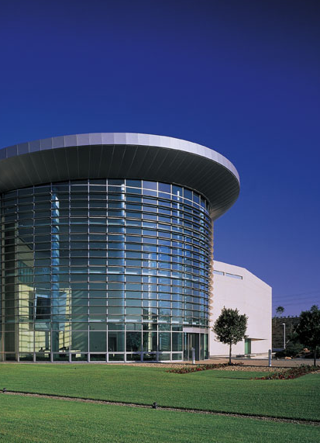
OUR COMPANY
A TRACK RECORD OF SUCCESS!
Founded in 1975 in Japan
Over 33 years of superb service
$Billions in sales since inception
Operations in OVER 40 countries
5A1 Dun & Bradstreet Rating
Debt Free
Millions of Satisfied Consumers
Pioneered: Wellness Home
Clinically Proven Technologies

Slide 35
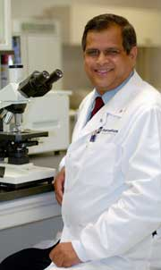
A worldwide team of scientists directed by Dr. A. S. Narain Naidu are responsible for creating OsteoDenx.
Consultants governments globally
Faculty in Europe, Asia, and U.S.
Medical Microbiologist
4 Successful Bio-tech Companies
1980’s U.S. Beef Industry: E.coli
Toxic shock syndrome
Holds multiple patents
Consultant to pharmaceutical and medical enterprises worldwide.

Slide 36


Bio-Replenishment
research and development
www.nterminus.com

Slide 37

Bio-Replenishments
Products based on the body’s own biochemicals and internal building blocks.
Bio-Replenishments are designed to enhance the use or synthesis of the bodies own bio-chemicals enabling the physical processes that keep us alive and healthy.

Slide 38
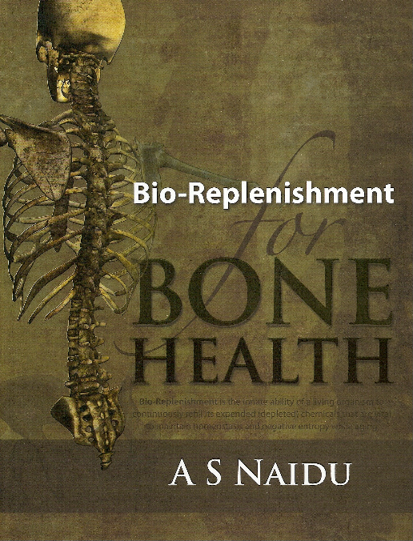

Slide 39
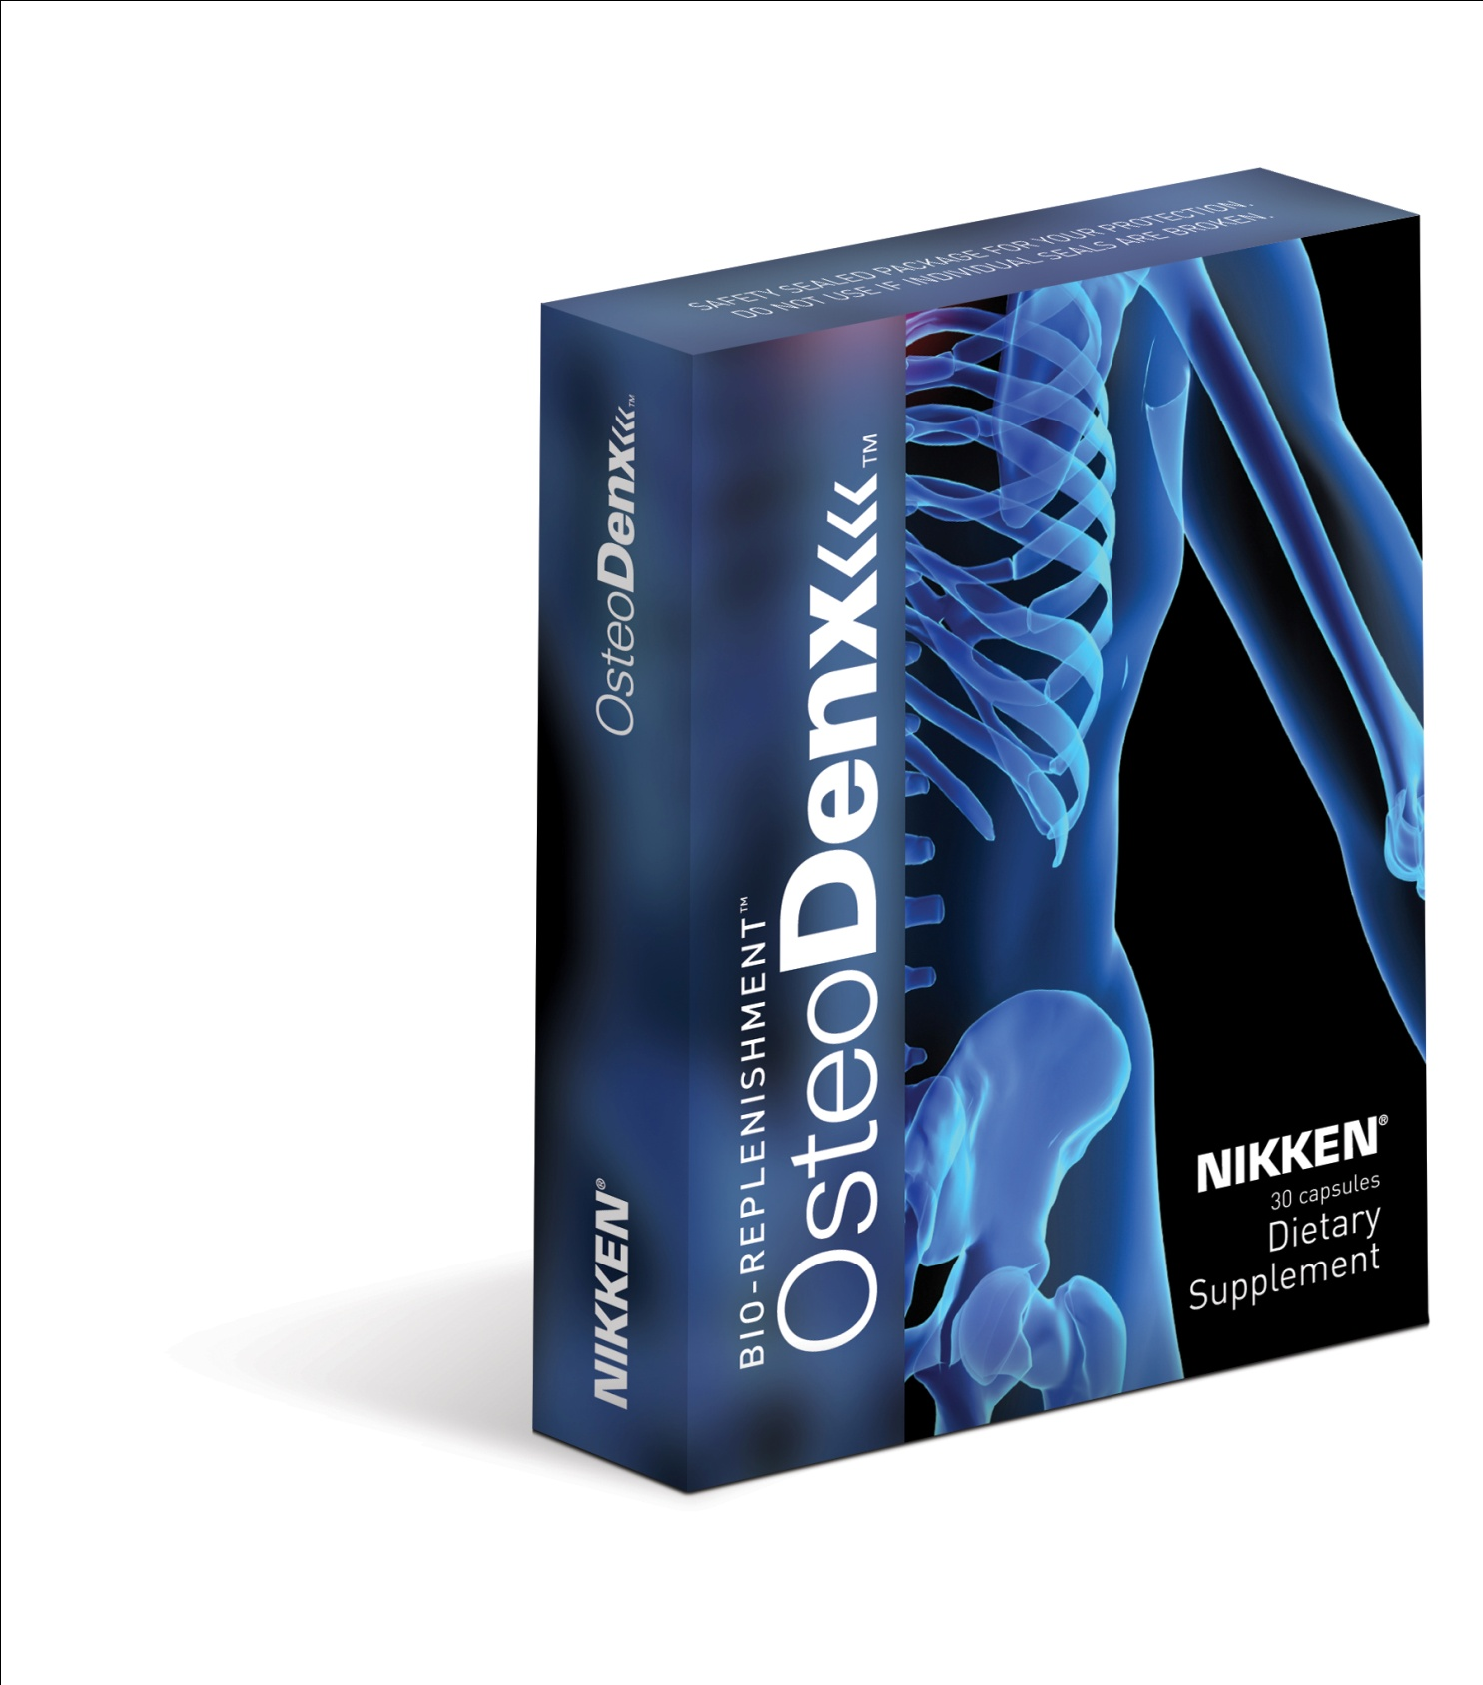
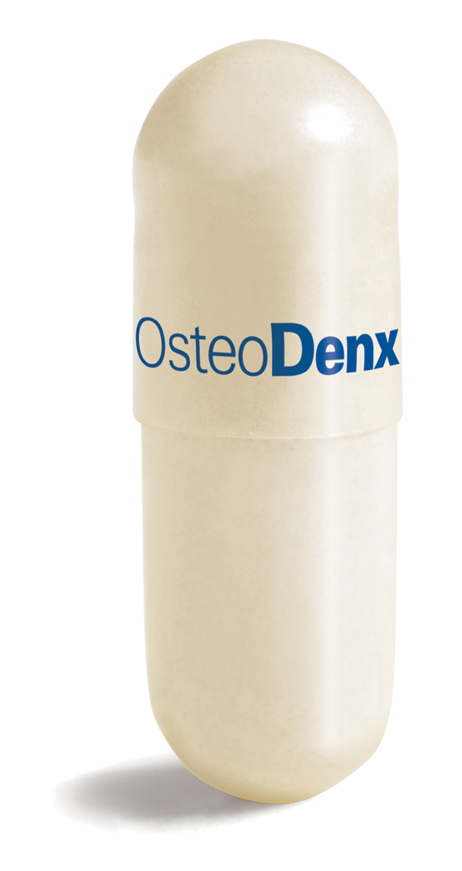
The OsteoDenx Difference.
Patented transport system
Natural replenishment of
calcium and other minerals
Targeted transport system
Helps in biochemical conversion and absorption
*These statements have not been evaluated by the Food and Drug Administration.
This product is not intended to diagnose, treat, cure or prevent any disease.

Slide 40

Syno-Portin Technology
… is an Osteodenx exclusive.
An innovation enabling vital ingredients to reach the specific target site —
the joint area, or synovium — for improved bioavailability.
This technology actually promotes and enhances the physical process of replacing bone tissue.

Slide 41
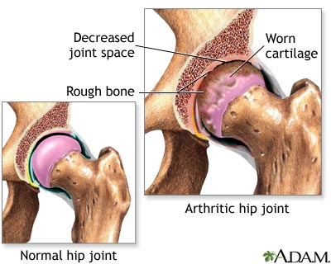
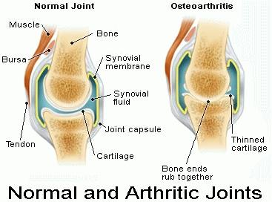
OsteoDenx
Syno-Portin Technology
Optimal balance of minerals
in bones and joints
Maintain bone density
Supports structure and integrity of joint cartilage.
20-plus years research
Published in leading medical journals.

Slide 42
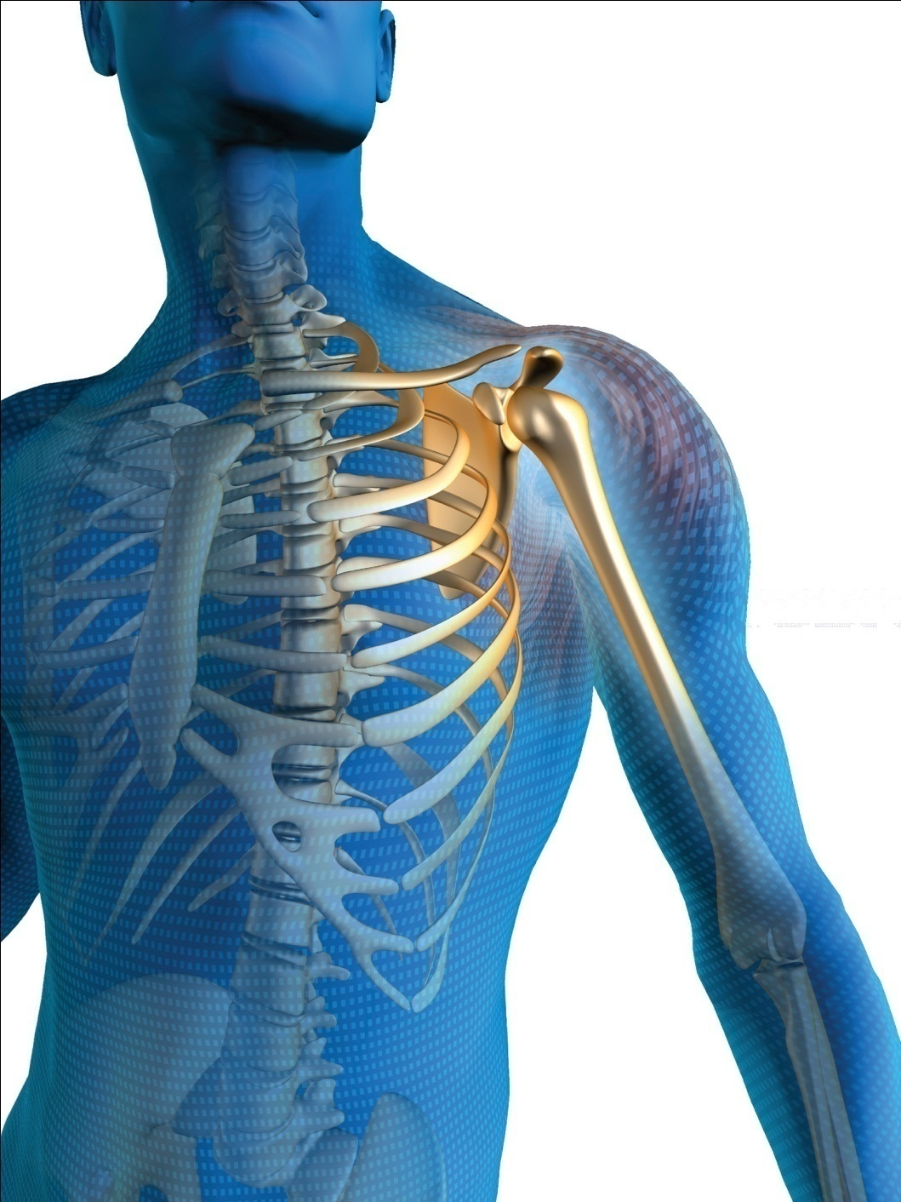
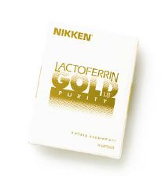
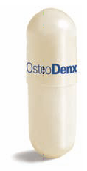
» VegeCap™
» Daily serving
One OsteoDenx capsule per day provides a measured, specific amount of essential support for bone health.
Capsules are all-vegetable VegeCaps, without gelatin or other animal byproducts.
Best absorption occurs when taken with Lactoferrin Gold 1.8
“An ounce of prevention is worth a pound of cure.” -Ben Franklin

Slide 43
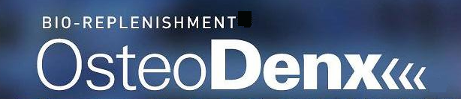
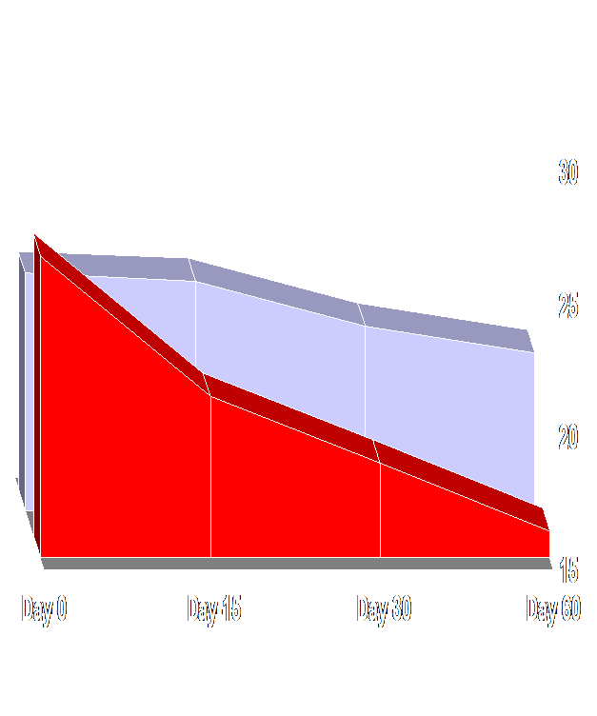
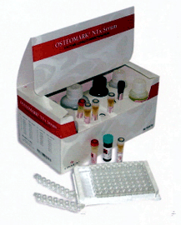
TM
Bone Resorption (LOSS)
TM
Serums indicated OSTEODENX could slow down bone loss by 25% compared to Control Group
CONTROL
Serum NTx levels (nM BCE)
OSTEODENX
N-telopeptide – bone collagen marker
* These statements have not been evaluated by the Food and Drug Administration. This product is not intended to diagnose, treat, cure or prevent any disease.

Slide 44
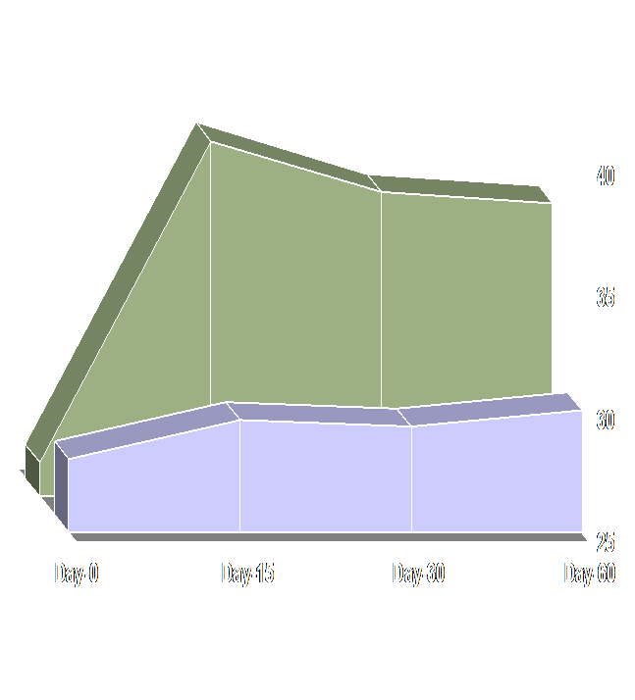
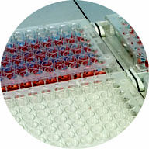
TM
Bone Formation
TM
Serums indicated OSTEODENX increased new bone forming cells by 43% compared to Control Group [within 15 days].
OSTEODENX
Serum BSAP levels (U/L)
CONTROL
Bone-Specific Alkaline Phosphatase
* These statements have not been evaluated by the Food and Drug Administration. This product is not intended to diagnose, treat, cure or prevent any disease.

Slide 45
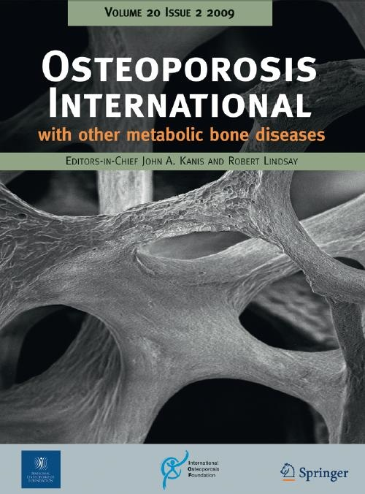
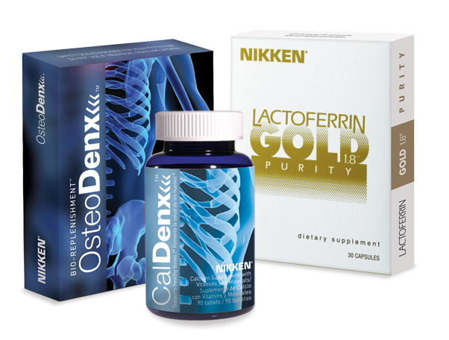
Osteoporosis International; 2009, Jan 27.
Promotes formation of new capillaries
Promotes bone formation.
A ribonuclease-enriched lactoferrin supplement studied here, (market name OsteoDenx) demonstrates significant reduction in resorption and increase in formation, towards restoring the balance of bone turnover within 6 months.
“…initiates cellular differentiation.”

Slide 46
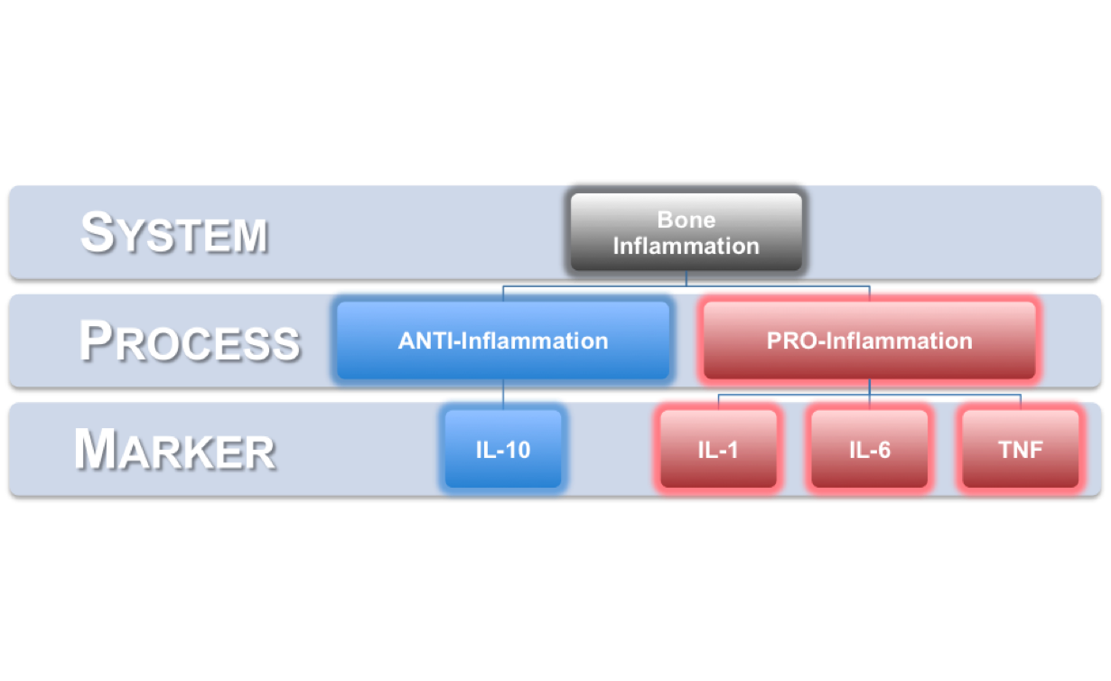
Clinical Study PART-2
OsteoDenx® and Bone Inflammation
“Inflammation Research” May 2010
* Highly specific and accurate bone markers - measures real-time bone inflammation
* Same bone inflammation markers used in pharmaceutical clinical trials

Slide 47
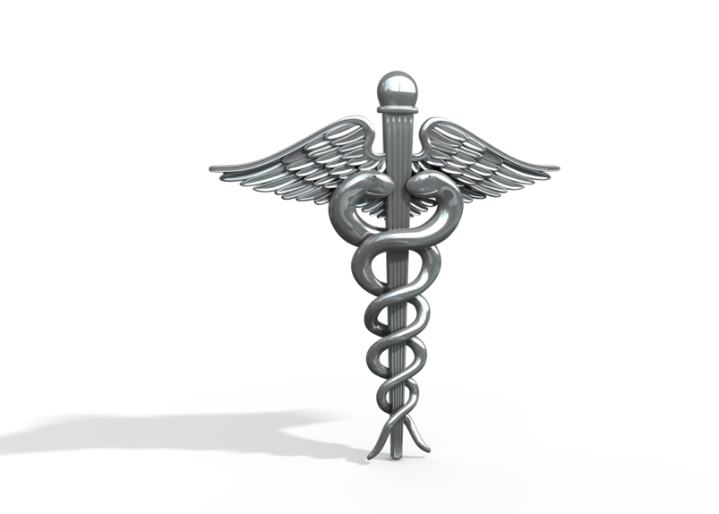
OsteoDenx®
Publication:
“Inflammation Research”
May 2010
Anti-Inflammation
IL-10 levels ELEVATED 140%
Pro-Inflammation
IL-1 DECREASED
IL-6 DECREASED
TNF DECREASED
Range: 10-44%

Slide 48
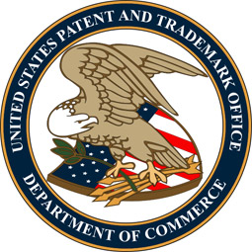
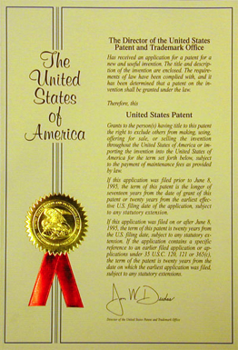
OsteoDenx®
PATENTS
US 7,125,963
US 7,326,775
US 7,601,689

Slide 49
Lactoferrin
Absorb and utilize iron and trace minerals.
29 distinct forms. Intercellular communication. Transport mechanism.
Antibacterial, antifungal, antiviral and antiparasitic activities with no issues of microbial drug-resistance.
Elimination and neutralization of toxic compounds, free radicals, maintain regularity.
Antioxidant absorption.
Fertility, Anti cancer, halts growth of periodontitis-causing bacteria

Slide 50
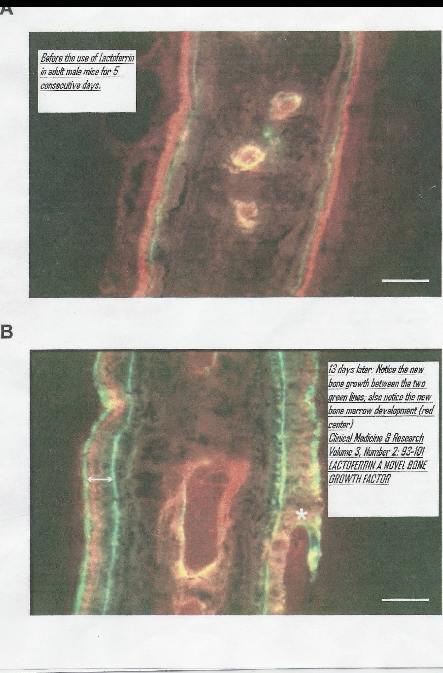
Lactoferrin: A Novel Bone Growth Factor (Clinical Medicine & Research)‏
Before Lactoferrin
Old weak bone
Unhealthy yellow marrow
13 days after Lactoferrin
Young strong bone
With healthy marrow
Notes:
50

Slide 51

Notes:
This chart gives a comparison between other bone & joint products vs. OsteoDenx & CalDenx. There really is no comparison.

Slide 52

Bio-Replenishment
Solutions

Slide 53
Bio-Replenishment
Solutions
$168 Retail

Slide 54



Bio-Replenishment
Solutions
Purchase individually or as a Pack
Member 15%
Consultant 20%
Autoship 10% More!
$120.60 Wholesale Autoship

Slide 55

Bone Wealth Opportunity
Global Marketing Rights
Story - Never Been Told
Lawsuits
Media Driven
Drug funding changes
Low Startup - Easy to Duplicate
Society is Looking for Opportunity!
Tax Deductions/Benefits

Slide 56

























Share with 5 = $50.00
5 share to 5 = $0 to you
25 share to 5 = $0 to you
125 share to 5 = $0 to you
625 share to 5 = $0 to you
Share with 5 = $30 mo
5 x 5 = $180 a mo
25 x 5 = $930 a mo
125 x 5 = $4,680 a mo
625 x 5 = $23,430 a mo
6%
$100.00 mo

Slide 57

$ 35.00
$ 120.60
$ 15.00
$ 603.00
$ 773.60

Slide 58

OUR INCOME VEHICLE
THE NIKKEN COMPENSATION PLAN
Imagine a Business Opportunity that Provides:
Sales Profits
Pak and Matching Bonus
Residual Income
Leadership Bonuses
Incentive Programs
  Sponsorship, Travel.
  Auto and Home Bonus
$1M Ambassador Bonus

Slide 59




Slide 60
Timing…
Ground Floor
$100,000,000,000.⁰⁰
Sales Volume
($100 Billion) Bone and Inflammation Market
What part of…
$100+ Billion
will be yours?
$20.8 Billion (Potential Osteoporosis Market)
0.003%
$10.4 Billion Osteoporosis Meds
3/1000ths of 1%
Time

Slide 61

Fast Track to Silver
Your Freedom Path:
Join the Team.
Get on the “Ship” (Autoship).
“Pack” for the Journey.
Get your “Map” (Register for HBM Training).
“Harness” the Perfect Storm – plan first events.

Slide 62

We Have a Choice
Are pharmaceuticals really the answer?
Wellness Home or
Nursing Home?
Will your insurance cover the funeral expenses too?
It’s all about Choices.

Slide 63



Create Your Own Stimulus Package…
Choose your own hours.
Part/full time.
Design a life!
Choose who you work with.
You decide how fast you go.
Black/white, male/female, rich/poor.
“Dig your well before you need it.” - Ed Wiens
What would happen if you could not work tomorrow?

Slide 64

Be Proactive In your Bone Health
Do You Brush Your Teeth?
THE CHOICE IS YOURS!
Take extra calcium which may NOT get into your bones, not solve the bone density problem but can cause other health issues.
Take a pharmaceutical which does not solve the bone problem but MAY cause other serious health challenges with side effects.
Take a natural, proven product without side effects that does solve the bone density problem and helps in other problem areas as well.
Contact your Wellness Manager to get the right solution for you.

Slide 65

PROACTIVE
REACTIVE

Slide 66



The ground-breaking innovation in Bone Health
Discover it. Live it.

