Slide 1
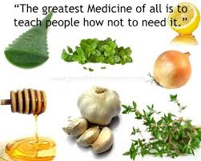
Presenting… Kenzen Vital Balance Meal Replacement Mix Nutritional Support Fat Loss Assistance
Food for Action
Food for Thought
“Let food be your medicine”..Hippocrates

Slide 2
The Problem
Obesity, Fatigue and Cognitive Problems

Slide 3
The Solution
Kenzen Vital Balance Daily
How Does IT Work?
Really Well!

Slide 4
“On the Vital Balance eating program you will transform your body's ability to digest sugars properly by regulating your insulin level.” How?
By giving your pancreas a well-deserved break, by cutting out simple and complex carbs, until you've reached your weight loss goal”
This is a real solution to these problems, not some yo-yo diet and certainly not diet pills to further mess up your metabolism. We looked for lasting results with real, wholesome foods teaching you key lessons that empower you to get results.
On average, women lose weight at the rate of 3 to 5 pounds per week and 4 to 7 pounds per week for men.

Slide 5
Lesson Number 1:
Learn to live off of your body's own fat reserves.
Your body gets its energy from three reserves: carbohydrates, protein and fats.
The body first burns energy from its simple and complex carbohydrate reserves and, when depleted, turns simultaneously to its protein and fat reserves for energy.

Slide 6
Lesson Number 2:
Your body only stores three days worth of carbs. Because of this, the Vital Balance Diet has a beginning and an end, like a treatment. Until you reach 100% of your weight loss goal, we restrict all sugars from your diet, even healthy fruits and those vegetables that have a high sugar content such as corn, potatoes, beets, peas, carrots and the like.
4 grams of carbohydrates is equal to 1 teaspoon of sugar.

Slide 7
Why? As long as sugar is entering your system, you're not burning fat. It's as simple as that. Remember, your body first takes its energy from your carb reserves. The idea is to deplete your carb reserves completely in order to get your body to turn to its fat to burn calories.
When you put too many grams of carbs into your system, your pancreas senses danger, zeros out the danger with insulin, your body realizes it has no more sugar, thus craves more sugar, you eat more carbohydrates, too many actually and the vicious cycle in on and repeating.

Slide 8
How do we get the body to burn its fat reserves and not its muscle mass reserves, if both are depleted simultaneously? A number of ways.
By providing your body with foods that have a very high protein value, complete with nutrients essential amino acids, 98%+ absorbable, which make them biologically-complete proteins.
We supplement your body with whole food nutrient-rich supplements such as a multi-vitamins, calcium, magnesium and potassium, which is the key ingredient in muscle building, and electrolytes to replace those normally found in foods restricted on the eating plan.

Slide 9
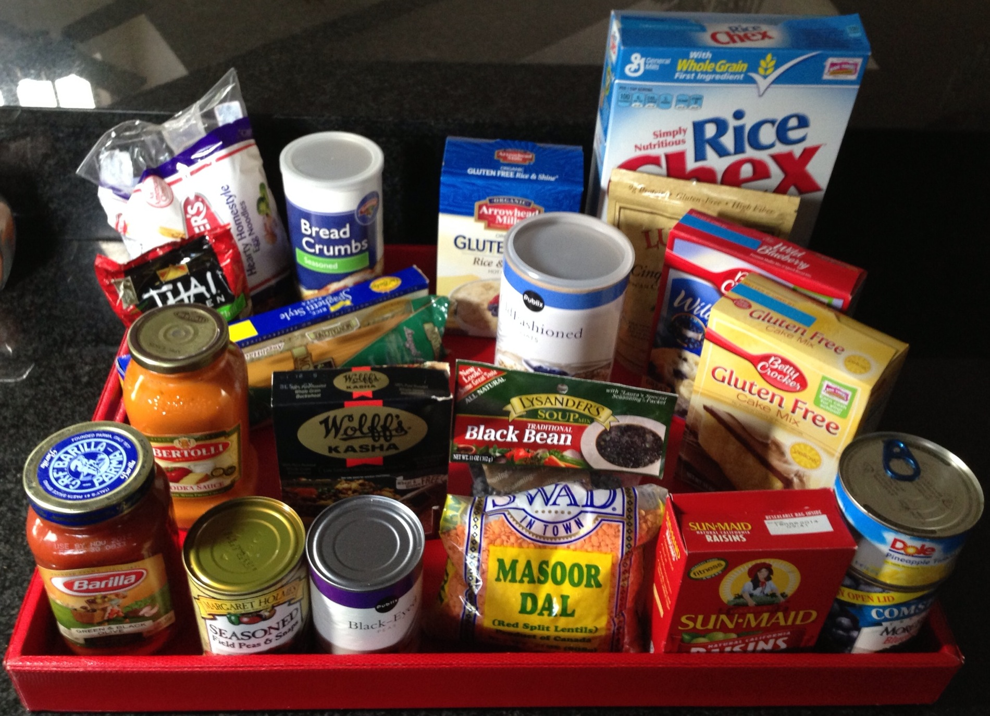

Slide 10
1 teaspoon of sugar = 4 grams of carbohydrates
A typical American “healthy” breakfast
8 oz glass orange juice = 26 gram carbs = 6.5 tsp sugar
1 cup oatmeal = 54 gram carbs = 13.50 tsp sugar
1/8 cup raisins = 15 grams carbs = 3.75 tsp sugar
2 tsp brown sugar = 8 gram carbs = 2 tsp sugar
1 piece whole grain toast = 44 gram carbs = 11 tsp sugar
Breakfast total = 147 gram carbs = 36.75 tsp sugar
When we are looking to reduce our weight, limiting our carbs to as low as possible is necessary to burn fat, say 30 to 50 grams of carbs a day, about 7 to 12 tsp of sugar a day.

Slide 11
A “Healthy” American lunch.
Black Beans and Rice
2 cup of black beans =248 gram of carbs = 62 tsp sugar
1 cup brown rice = 66 gram of carbs = 16.50 tsp sugar
Cuban bread 1/2th loaf = 112 gram carbs = 28 tsp sugar
Lunch total = 426 gram carbs = 106.50 tsp sugar
Pancreas is saying “Danger, danger, danger!”

Slide 12
Dinner: Spaghetti & Meatballs
Spaghetti pasta (regular or gluten free)
¼ box = 46 gram carbs = 11.5 tsp sugar
Spaghetti sauce ½ cup = 13 gram carbs = 3.25 tsp sugar
Homemade meatballs = 6 gram carbs = 1.5 tsp sugar
Garlic bread 2 sm slices = 42 gram carbs = 9.5 tsp sugar
2 glasses of wine = 42 gram carbs = 9.5 tsp sugar
1 slice cheesecake = 33 gram carbs = 8.25 tsp sugar
Total for this tasty meal = 182 gram carbs = 45.5 tsp sugar

Slide 13
One day of carbs & sugar
Breakfast total = 147 gram carbs = 36.75 tsp sugar
Lunch total = 426 gram carbs = 106.5 tsp sugar
Dinner Total = 182 gram carbs = 45.5 tsp sugar
Total for day = 755 gram carbs = 188.75 tsp sugar
Which is 4 cups of sugar
Limiting our carbs to as low as possible is necessary to burn fat, say 30 to 50 grams of carbs a day, from vegetable sources, which is about 7 to 12 tsps. of sugar a day.
The primary purpose of insulin is to turn sugar into FAT!

Slide 14
Vital Balance Eating Plan PROTOCOL
Cutting out sugar, fruits, grains and carbohydrates for 7 days will curb your sugar cravings.
Protein Only means: No sugar, no fruit, no juice, no grains, no beans, no starch.
Protein can be eggs, meat, fish, hemp seeds.
(NO: potatoes, tomatoes, yucca)
BREAKFAST | LUNCH | DINNER | SNACKS
Before Noon. Protein only breakfast! Can be the Kenzen Vital Balance Meal Replacement shake. Can be eggs, meat protein, omelets Optional: 1 cup coffee/TEA With real cream but without sugary creamer WATER | Can be the Kenzen Vital Balance Meal Replacement 1 digestive enzyme* Salad with lemon juice, spices & 1-2 tsps. olive and lemon. You may add in meat protein, tuna or egg salad made with real mayonnaise. Hemp seeds. WATER | 1 digestive enzyme… *whenever you are not having the Kenzen Vital Balance Meal replacement. 7 oz of Seafood Chicken, turkey Beef or 2-3 eggs with vegetables Can be the Kenzen Vital Balance Meal replacement WATER | Can be Frozen Kenzen Vital Balance Meal shake with unsweetened coconut flakes & toasted almonds Celery or other vegetables with peanut or almond butter WATER

Slide 15
“Take your body weight, cut it in half, this is how many grams of protein your body needs everyday to reduce weight, it is also the number of ounces of PiMag living water your body needs every day.”
After noon all true vegetables are ok. Reducing or cutting out dairy will increase your results. You may take Ciaga & Bergesterol after noon with a meal too. Liver support may add to your success as will exercise. Nikken's Mega Daily 4 is also helpful. Quicker results occur with 2 Kenzen Vital Balance Meal Replacement shakes a day replacing meals.
Unlimited: Algae, asparagus, beet greens, broccoli, Chinese cabbage/red cabbage, cauliflower, celeriac, fiddleheads, hot peppers, kale, leeks, green peppers, mushrooms, onions/raw, shallots/raw, sorrel, sauerkraut, Swiss chard, turnip, watercress, zucchini, alfalfa, Bok Choy, celery, cucumber, daikon radish, fennel, salad, radish, seaweed, soy bean sprouts, spinach, dill pickles, lemons, pickle juice, herbs. Himalayan Sea salt.
2 times a week: Eggplant, Brussels sprouts, palm hearts, wax beans, green beans, tomatoes
Phase two: Same as above, just replace one protein shake for a 2nd Dinner Protocol either for breakfast or lunch. Anytime you have a bad eating day, the next day is a recovery day of Phase one. 30 minute support call Tuesday & Friday mornings @ 8:30 AM Eastern Time 218-548-8267 pin code 1818#. You have 4 times the success with support.
In addition to weight loss, this diet is to repair and reduce the stress on your pancreas. We recommend Nikken whole foods organic nutrition in the support of this plan along with the PiMag Water. Except for with the Kenzen Meal Replacement Shake, I recommend taking one digestive enzyme with each meal. Additional nutritionals are suggested. Contact your Independent Nikken Consultant for your personal coaching and suggestions. To your health!

Slide 16
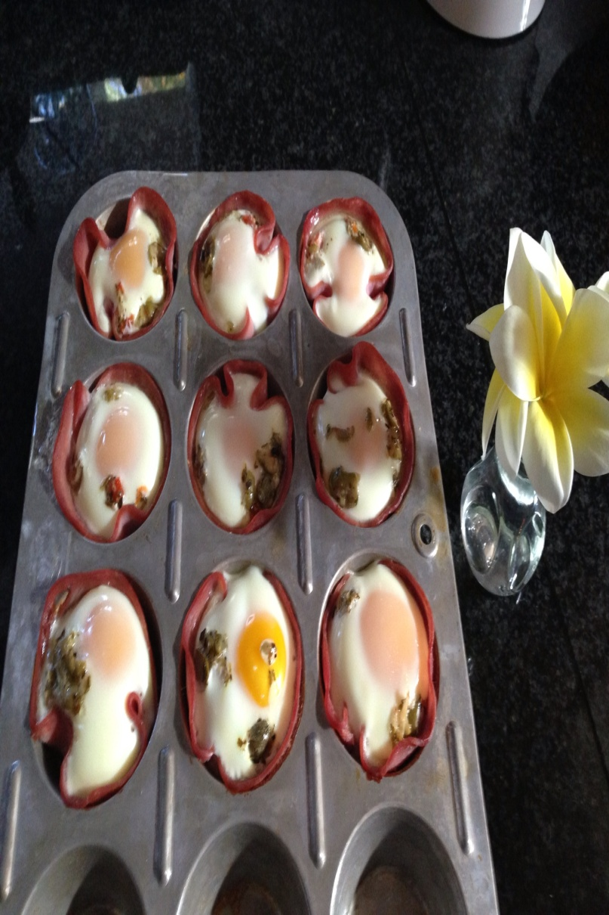
I highly recommend you try these out the next time you are craving something different for your breakfast, brunch or a snack. Here’s what you do: 1) Spray each muffin well with nonstick spray. 2) Place a slice of “naturals” turkey or other lunch meat in the bottom of each muffin well. 3) Break one egg into each spot. 4) Sprinkle a little bit of salt and pepper on each. Optional, sprinkle green onion & parmesan on top of each egg or olive tapenade. 7) Bake at 350 degrees for 18-20 minutes or until the yolks are as firm as you desire and the whites are cooked through.

Slide 17
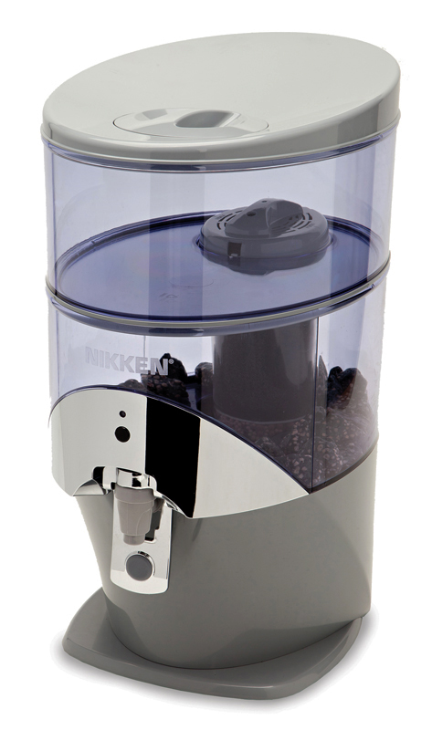
Introducing the NEW PiMag® Waterfall™
NEW patent-pending design
NEW patent-pending technology
NEW certified water quality

Slide 18
Introducing the NEW PiMag® Waterfall™
Certified by U.S. Water Quality Association
(Takes out all the bad stuff)
Internationally recognized standards ANSI/NSF Standard 42 & 53
For chlorine, chloramine, taste and odor
Class III particulates
For VOCs and heavy metals
Exceeds required specifications

Slide 19
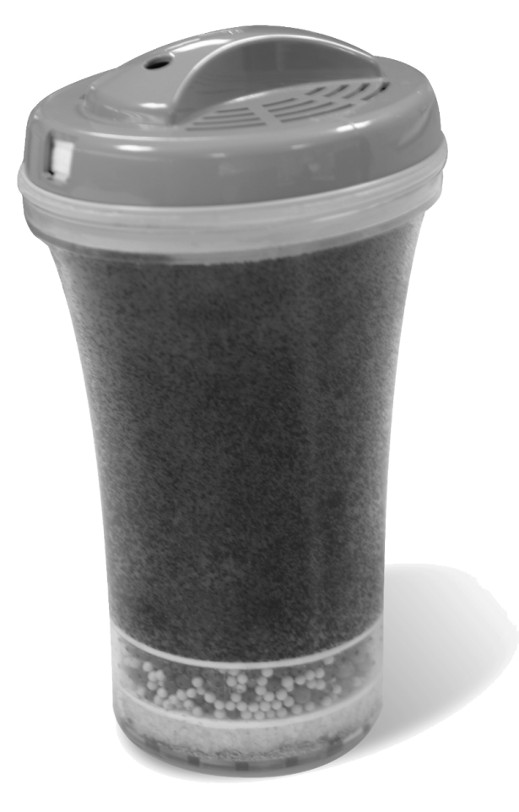
PiMag® Technology
Pi materials in filter
Adds trace minerals
Balances pH to make more alkaline 8.5 – 9.5
Helps balance an acidic diet, environment
Reduces ORP (oxidation rate potential) or rust and rot.

Slide 20
Green Technology
PiMag® Waterfall is made exclusively with recyclable and biodegradable materials
Contains no BPA (bisphenol A)
No concerns with chemical leaching into water
Recyclable, reduced environmental impact

Slide 21
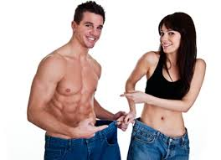
Kenzen Vital Balance Meal Replacement Mix
Only 125 Calories per Serving when mixed with PiMag Water, or unsweetened almond milk.
To maintain weight - consume in place of breakfast or lunch at least 3 to 7 times a week.
To lose weight - replace one or two meals 7 to 14 times a week and only mix with water or almond milk (no carbohydrates) to change brain chemistry & decrease sugar cravings. Eat a balanced lunch and dinner add a healthy salad to the meal you have the shake with too. Exercise is also key.

Slide 22
Kenzen Vital Balance Meal Replacement Mix
A Functional Food:
Helps people of any age stay healthy
Designed by a team of scientists
Based on biological research
Supports cognitive function
Contains a blend of 7 enzymes to aid digestion
NO added salt, dairy, soy, whey, lactose or GMO
Vegan & Kosher certified and Gluten free

Slide 23
Kenzen Vital Balance contains: Support for:
All natural Ingredients Nutrient absorption
Antioxidants Appetite regulation
Digestive Enzymes Cleansing (for toxic elimination)
Medium-chain triglycerides Cognitive (mental) function
Natural 3rd generation Stevia Digestive health
Natural vanilla Formation of lean muscle
Probiotics Immune system health
Vegetable protein Metabolic fat burning
Vitamins

Slide 24
Kenzen Vital Balance does NOT contain:
Added salt Fructose
Sugar Gluten
Animal protein GMOs
Antibiotics Lactose
Artificial chemicals Preservatives
Artificial coloring Soy
Artificial flavoring Sucralose
Aspartame Whey
Filler Yeast

Slide 25
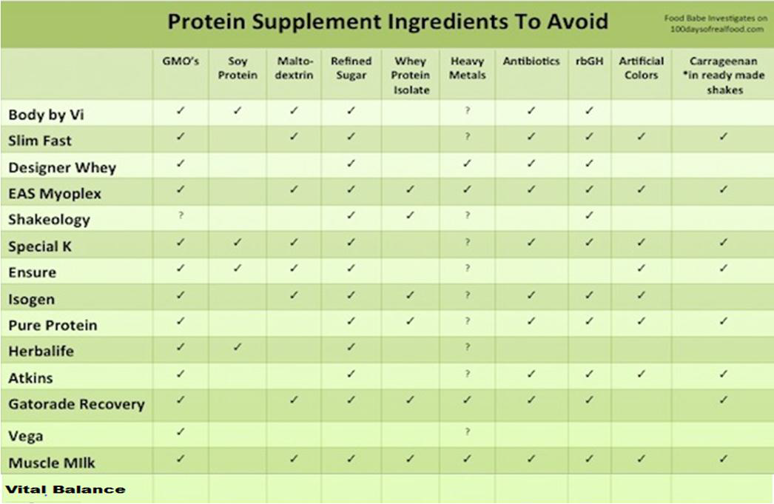
see also http://www.100daysofrealfood.com/

Slide 26
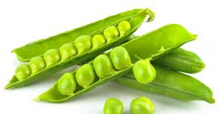
Kenzen Vital Balance “The Details”
Proteins: Take your body weight & cut it in half, this is how many grams of protein your body needs.
Offers 18 grams of organic vegetable proteins per serving
pea, rice, chlorella & hemp, providing a complete protein
helps formation of lean body mass
no saturated fat or the calories of animal protein

Slide 27
All Food is made up of Protein, Fat or Carbohydrate and each ultimately goes through various pathways to create energy in the form of ATP

Slide 28
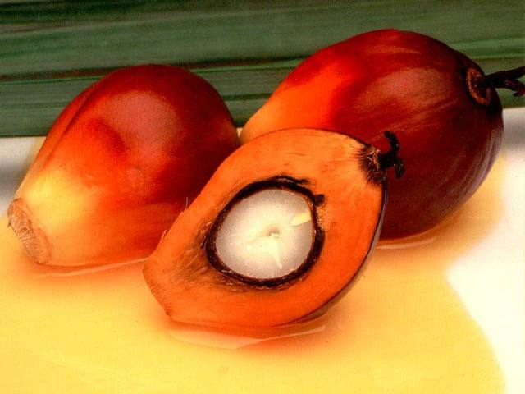
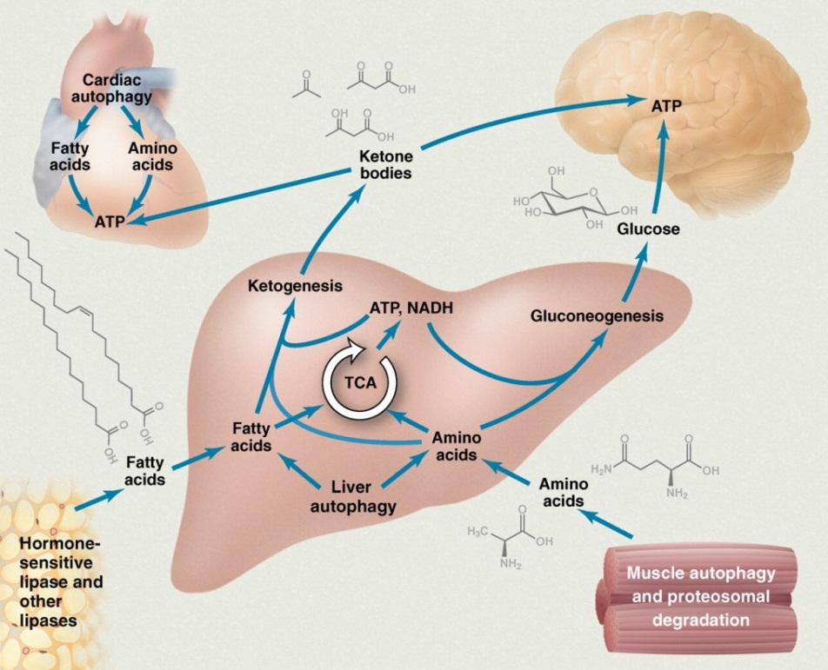
Kenzen Vital Balance Meal Replacement Mix
Magic Medium-chain Triglycerides (MCTs)
“the fat that makes you thin”
From natural Palm Oil which also contains antioxidants (beta-carotene, tocotrienols & tocopherols)
Converted to ketone bodies by
the liver to go directly to the brain
and heart (unlike LCTs or saturated fats)

Slide 29
Kenzen Vital Balance Meal Replacement Mix
No impact on insulin levels
Triggers “thermogenesis” that increases metabolic rate
Supports mental acuity by providing immediate brain tissue nourishment & cell replenishment

Slide 30
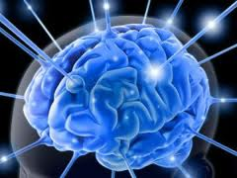
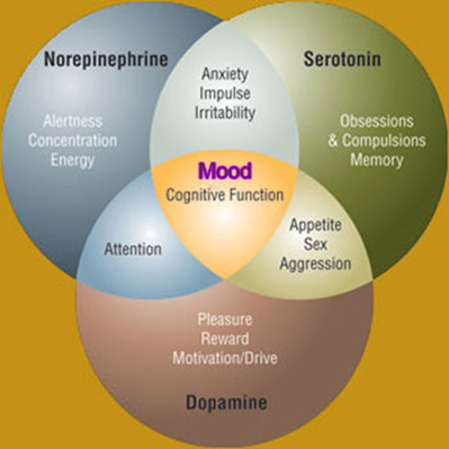
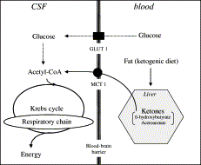
Kenzen Vital Balance Meal Replacement Mix
Protein increases tyrosine which promotes alertness & energy. Do not mix with Carbohydrates eg milk, juice, fruit etc as they cause fatigue by increasing tryptophan used to make serotonin which calms, this is not what you want in the AM!)
If used with water first thing in the AM:
Ketone bodies from MCT’s bypass glucose breakdown to produce energy

Slide 31
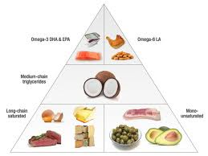
Kenzen Vital Balance Meal Replacement Mix
Benefits linked between MCTs and memory problems associated with aging according to clinical research
Helps control appetite
Appears to make you happier
International Journal of Food Science and Nutrition
Journal of Nutrition, March 2002

Slide 32
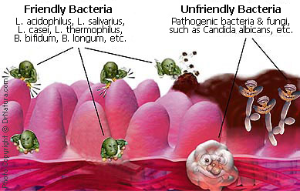
Kenzen Vital Balance Meal Replacement Mix
Probiotics:
There are 100 trillion bacteria in the gut ”good bacteria preventing harmful microbes from entering the body”
Help digest carbohydrates
Helps absorb minerals
Produces certain vitamins
Responsible for absorbing more than 10% of daily calories
Contributes to healthy immune function

Slide 33
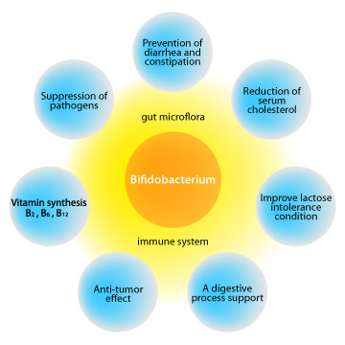
Kenzen Vital Balance Meal Replacement Mix
Each serving contains over 2 billion CFUs of Lactobacillus plantarium and Bifidiobacterium bifidum.
Yogurt pickles and sauerkraut increase the same good bacteria
One serving of Vital Balance contains more helpful bacteria than 10 containers of yogurt
Advances in Immunology, Volume 107, 2010
Journal of the American Dietetics Association, March 2008

Slide 34
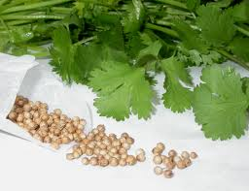
Kenzen Vital Balance Meal Replacement Mix
Cilantro
Natural, Organic Detoxifiers:
There are natural and man-made toxins in our physical environment
Cilantro (coriander) & open-cell chlorella, recognized as beneficial in assisting removal of heavy metals from body
Synergistic combination with organic alfalfa,
spirulina, broccoli & spinach also contained in
Vital Balance (check INR if on warfarin, coumadin)
Chlorella

Slide 35
Kenzen Vital Balance Meal Replacement Mix
The new Nikken shake delivers…
1 minute Testimonials?

Slide 36
Kenzen Vital Balance – The Summary
Better than other protein shakes on the market for meal replacement, for fat loss or and for nutritional supplementation. It is not just a shake!
Major Points:
18 gm of vegetable protein from pea, rice, chlorella & hemp
125 calories per serving
Magic MCT’s for direct heart and brain energy
Natural heavy metal detoxification with chlorella and cilantro
Probiotics for digestion and immune health
Digestive enzymes for better breakdown & absorption
Vitamins, & mineral supplementation
Contains your daily Green vegetables
Great vanilla taste with 3rd generation stevia
Cost: $3 per serving

Slide 37
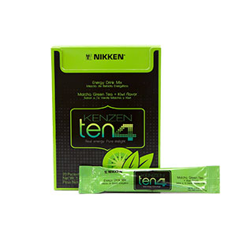
Ten-4 Organic Natural Energy
Wake up your body and mind the healthy way. Kenzen Ten4 is made with real ingredients – including what is known as “nature’s own energy drink,” naturally organic matcha green tea, and one of the most nutrient-dense superfruits, the New Zealand kiwi. Whether it’s 10 am or 4 pm, you’ll experience up to 6 hours of energy, a feeling that supercharges you mentally and physically.
Ten4 offers 80 mg of natural caffeine and is made with organic ingredients. It helps burn calories, boost metabolism and support mental alertness. With vitamins B6 and B12 for quick pickup and nutrient-rich kiwi, Kenzen Ten4 has only 25 calories, 5 grams of real organic cane sugar and a light tropical tea taste that you can enjoy any time of day. No artificial flavors, sweeteners, color or preservatives — it’s real energy, pure delight.

Slide 38
Presenting… Kenzen Vital Balance Meal Replacement Mix Nutritional Support Fat Loss Assistance
Food for Action
Food for Thought
“Let food be your medicine”. Hippocrates

